Slide 1



Simulating OOP in JavaScript
Function Constructor, Prototypes, "this" Object, Classical and Prototypal Model
SoftUni Team
Technical Trainers
Software University
http://softuni.bg

Slide 2
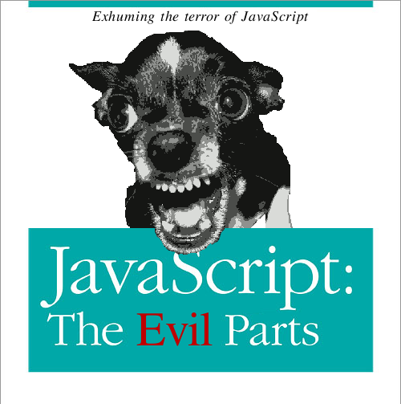
Table of Contents
Object-Oriented Programming
Is there OOP in JavaScript?
Classical OOP in JavaScript
Prototypes
Object Properties
Function Constructors
The value of the this object
Prototypal OOP

Slide 3
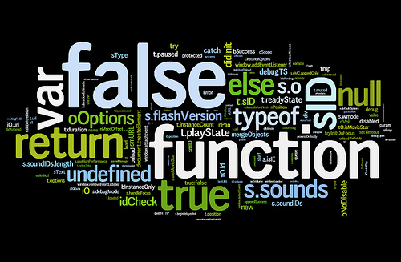
Object-Oriented Programming
And How It Works in JavaScript

Slide 4
Object-Oriented Programming
OOP means that the application is constructed as a set of objects
Each object has its purpose
Each object can hold other objects
JavaScript is prototype-oriented language
Uses prototypes to define its properties
Does not have definition for class or constructor
ECMAScript 6 will introduce classes

Slide 5
OOP in JavaScript
JavaScript is dynamic language
No such things as polymorphism
JavaScript is also highly expressive language
Most things can be achieved in many ways
That is why JavaScript has many ways to support OOP
Classical (Functional), Prototypal
Each has its advantages and drawbacks
Usage depends on the case

Slide 6
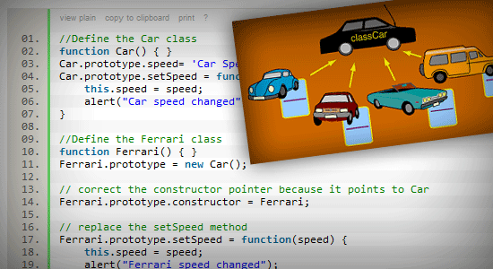
Classical OOP in JavaScript

Slide 7
Classical OOP
JavaScript uses functions to create objects
It has no definition for class or constructor
Functions play the role of object constructors
Create/initiate objects is done by calling the function with the "new" keyword
There is no need to explicitly define a constructor method
function Person() {}
var gosho = new Person(); // instance of Person

Slide 8
Creating Objects
When using a function as an object constructor it is executed when called with new
Each of the instances is independent
They have their own state and behavior
function Person() {}
var gosho = new Person(); // instance of Person
var maria = new Person(); // another instance of Person
gosho.name = "George";
maria.name = "Maria";
console.log(gosho.name); // George
console.log(maria.name); // Maria

Slide 9
Function Constructor with parameters
Function constructors can take parameters to give different state to instances
Just a regular function with parameters, invoked with new
function Person(name, age){
console.log("Name: " + name + ", Age: " + age);
}
var gosho = new Person("Georgi", 23);
// Name: Georgi, Age: 23
var maria = new Person("Maria", 18);
// Name: Maria, Age: 18

Slide 10

Function Constructors
Live Demo

Slide 11
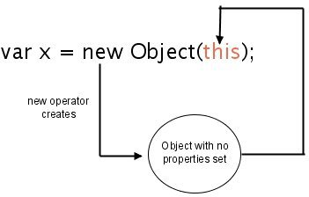
The new keyword

Slide 12
The new keyword
How does the new keyword work in JavaScript?
Invoke constructor passing the new object as this
Get all arguments except the first one
function newObject(func) {
var args = Array.prototype.slice.call(arguments, 1);
var object = Object.create(func.prototype);
var result = func.apply(object, args);
return (typeof result === 'object' && result) || object;
}
Create a object with prototype func prototype
Return the new object
var pesho = newObject(Person, "Peter", "Shmatov");
var pesho2 = new Person("Peter", "Shmatov");
The same
The same

Slide 13

The new keyword
Live Demo

Slide 14

Prototypes
The Prototype Object in JS

Slide 15
The Prototype Object
JavaScript is prototype-oriented programming language
Every object has a hidden property prototype (parent object)
E.g. String.prototype holds the String instances functions
Prototypes give properties to all instances
The Object type is the parent of all objects
Every object inherits Object and has toString() method
constructor
Specifies the function that creates an object's prototype

Slide 16
The Prototype Object - Example
When adding properties to a prototype, all instances will get them
String.prototype.repeat = function (count) {
var str, i;
str = '';
for (i = 0; i < count; i += 1) {
str += this;
}
return str;
};
var s = "hi".repeat(2); // "hihi"
Add repeat(count) method to all string objects
Here this means the string itself

Slide 17
Prototypes
Demo
Live Demo

Slide 18
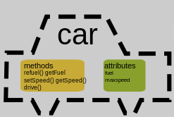
Object Members
Attaching Properties and Methods

Slide 19
Object Members – Properties
Objects can also define custom state
Custom properties that only instances of this type have
Use the keyword this to attach properties to object
function Person(name, age) {
this._name = name;
this._age = age;
}
var maria = new Person("Mariika", 18);
console.log(maria._name); // Mariika
maria._name = "Peter";
console.log(maria._name); // Peter

Slide 20
Object Members - Methods
Property values can be either variables or functions
Functions attached to object are called methods
function Person(name, age) {
this._name = name;
this._age = age;
this.sayHello = function() {
console.log("My name is " + this._name +
" and I'm " + this._age + "-years old");
}
}
var maria = new Person("Maria", 18);
maria.sayHello(); // My name is Maria and I'm 18-years old

Slide 21
Object Members
Live Demo

Slide 22


Attaching Methods to the Prototype

Slide 23
Attaching Methods
Attaching methods in the object constructor is a tricky operation
Its is slow (repeated at each object creation)
Every object has a different (duplicated) function instance
function Person(name, age) {
this.introduce = function() {
return 'Name: ' + name + ', Age: ' + age;
};
}
var p1 = new Person();
var p2 = new Person();
console.log(p1.introduce === p2.introduce); // false

Slide 24


Better Method Attachment
Instead of attaching the methods to this in the constructor
Attach them to the prototype of the constructor
Methods attached to constructor's prototype are created exactly once
function Person(name, age) {
this.sayHello = function() {
// ...
}
}
function Person(name, age) { }
Person.prototype.sayHello = function() {
// ...
}

Slide 25
Attaching Methods to the Prototype
Live Demo

Slide 26


Pros and Cons when Attaching Methods
Attaching to prototype
Using JavaScript as it is meant
No hidden data
A way better performance
Attaching to this
Code closer to other languages
Hidden data
Not good performance
JavaScript is NO other language!
Hidden data is not a big problem. Prefix "hidden" data with _

Slide 27
The this Object

Slide 28
The this Object
this is a special kind of object
It is available everywhere in JavaScript
It has different meaning in different contexts
The this object can have two different values:
The parent scope
The value of this of the containing scope
If none of the parents is object, its value is window / global object
A concrete object
When using the new operator

Slide 29
this in Function Scope
When executed over a function, without the new operator
this refers to the parent scope
function Person(name) {
this._name = name;
this.getName = function getPersonName() {
return this._name;
}
}
var p = new Person("Gosho");
var getName = p.getName;
console.log(p.getName()); // Gosho
console.log(getName()); // undefined
Here this means the Person object
Here this means its parent scope (window)

Slide 30
The this Function Object
Live Demo

Slide 31
Function Constructors – caching this
this doesn't make a closure
The only way to make closure is to cache this in another variable
Then we can call functions without context
Doesn't work for methods attached to the prototype
Creating closure (holding this)
function Person(name) {
var self = this;
self._name = name;
self.getName = function getPersonName() {
return self._name;
}
}
var p = new Person("Peter");
var getPersonName = p.getName;
console.log(getPersonName()); // Logs: Peter

Slide 32
Function Constructors – call without new
JavaScript cannot limit function to be used only as constructors
JavaScript was designed for simple UI purposes
To mark something as contructor, name it in PascalCase
Convention: PascalCase-named functions should be called with new
function Person(name) {
this._name = name;
this.getName = function getPersonName() {
return this._name;
}
}
var p = Person("Peter");
What will be the value of this?

Slide 33

Invoking Function Constructors Without new
Live Demo

Slide 34
Function Constructor Fix
John Resig (jQuery) designed a simple way to check if the function is not used as constructor:
function Person(name, age) {
if (!(this instanceof arguments.callee)) {
return new arguments.callee(name, age);
}
this._name = name;
this._age = age;
}
If this is not of type the function, call the function with new

Slide 35
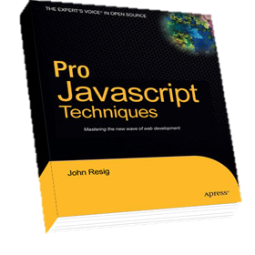
John Resig Constructor Fix
Live Demo

Slide 36

Function Constructors with Modules

Slide 37
Constructors with Modules
Function constructors can be put inside a module
Introduces a better abstraction of the code
Allows to hide constants and functions
var Person = (function () {
var MAX_NAME_LENGTH = 50; // private const
function Person(name) { // constructor
this._name = name;
}
Person.prototype.walk = // public method
function (distance) { … };
function calcDistance(…) { // private
… // function hidden in the module
}
return Person;
}());

Slide 38
Function Constructors with Modules
Live Demo

Slide 39

Hidden Functions
What to Do When We Want to Hide Something?

Slide 40
Hidden Functions
When a function constructor is wrapped inside a module:
The module can hold hidden functions
The function constructor can use these hidden functions
Yet, to use these functions as object methods, we should use apply(…) or call(…)
In order to pass correct this

Slide 41
Hidden Functions: Example
var Rect = (function () {
function validatePosition() {
// …
}
function Rect(x, y, width, height) {
var isPositionValid = validatePosition.call(this);
if (!isPositionValid) {
throw new Error('Invalid Rect position');
}
}
Rect.prototype = { /* … */ };
return Rect;
}());
This function is not exposed from the module
Using call() to invoke the function over this

Slide 42
Hidden Functions
Live Demo

Slide 43
Methods Attached to the Function Constructor
var Rect = (function () {
function Rect(width, height) {
this.width = width;
this.height = height;
}
Rect.prototype.calculateArea = function () { };
Rect.isSquare = function(rect) {
return rect.width === rect.height;
}
return Rect;
}());
Works as a static method. Invoked through the class, not through the instances.
Should not access this.

Slide 44

Prototypal OOP
Another Way to Work with Classes in JS

Slide 45
Prototypal OOP
Prototypal OOP uses the prototype nature of JS to produce objects
Objects are created from objects, instead from functions
Simple approach: all properties / methods are public
var Person = {
init: function(name) {
this._name = name;
return this;
},
introduce: function introduce() {
return "Hello my name is: " + this._name;
}
}
var pesho = Object.create(Person).init('Peter');
console.log(pesho.introduce()); // Name: Peter, Age: 69
The init() function works as a constructor
Creating an object from Person

Slide 46
Prototypal OOP
Live Demo

Slide 47
Difference between Classical and Prototypal Model
Classical OOP in JavaScript
Prototypal OOP in JavaScript
function Person(name) {
this._name = name;
}
var pesho = new Person("Peter");
var PersonPrototype = {
init: function personConstructor(name) {
this._name = name;
}
}
var pesho = Object.create(PersonPrototype);
pesho.init("Peter");

Slide 48







Simulating OOP in JavaScript
https://softuni.bg/courses/advanced-javascript/

Slide 49
License
This course (slides, examples, demos, videos, homework, etc.) is licensed under the "Creative Commons Attribution-NonCommercial-ShareAlike 4.0 International" license
Attribution: this work may contain portions from
“JavaScript OOP" course by Telerik Academy under CC-BY-NC-SA license

Slide 50





Free Trainings @ Software University
Software University Foundation – softuni.org
Software University – High-Quality Education, Profession and Job for Software Developers
softuni.bg
Software University @ Facebook
facebook.com/SoftwareUniversity
Software University @ YouTube
youtube.com/SoftwareUniversity
Software University Forums – forum.softuni.bg

